Slide 1
Trade Liberalization, Export and Product Innovation
Econometric Society Winter School in Dynamic Structural Econometrics
Combining Structural Estimation with RCTs and Quasi-Experiments
The University of Hong Kong
10-11 December, 2025
Sizhong Sun
College of Business Law and Governance
James Cook University
sizhong.sun@jcu.edu.au

Slide 2
Introduction
Arguably, innovation and export play an important role in a firm’s profitability and growth.
Researchers have explored innovation and export from different dimensions, both theoretically and empirically.
  Melitz and Redding (2021) highlight four key mechanisms through which international trade affects innovation, namely market size, competition, comparative advantage and knowledge spillovers
  Innovation can boost firms’ export, both in terms of extensive and intensive margins (Cassiman et al., 2010, Becker and Egger, 2013)

Slide 3
Introduction
Many of these studies explore international trade and innovation of forms other than product innovation.
Relatively fewer studies specifically focus on firms’ export and product innovation.
This paper intends to investigate firms’ decisions on export and product innovation both theoretically and empirically.

Slide 4
Introduction
Theoretically, we model firms’ behaviour in a multi-stage framework, where firms make optimal decisions on entry, exit, whether to innovate and export, the degree of product innovation, and prices in both the domestic and export markets which are monopolistically competitive.
The model features a mixed static and dynamic decision making.
Empirically , we bring the model to data of a sample of air-conditioner manufacturing firms in China from 2000 to 2007. In particular, utilizing an exogenous shock of China’s WTO accession in December 2001, we examine how this affects firms’ export and how the effect is transmitted to firms’ optimal decision to innovate.

Slide 5
Introduction
Identification Strategy:
By imposing a theoretical model over data
Utilize the structural relationship implied by the modelling;
Utilize the variations in the sample (e.g. Das et al. 2007), for example:
  Given an increase in marginal benefit of innovation (due to trade liberalization shock)
  Firms that never innovates: It takes time to start innovation (R&D personnel recruitment and facilities set-up);
  Firms that innovated previously: They can start new innovation more quickly by using existing facilities;
  Hence, there exists variations of response by these two types of firms, which can be used for identification purpose.

Slide 6
Introduction
We find
trade liberalization reduces the iceberg trade cost, ceteris paribus, which in turn promotes the value of export. The export promotion then improves firms’ probability of product innovation through three channels, namely a contemporaneous static effect and two dynamic effects.
Statically, trade liberalization promotes product innovation through a larger contemporaneous marginal benefit from a reduction of iceberg trade cost for exporting firms to innovate.
Dynamically, export helps firms to move to a better state in the future, which in turn increase firms’ probability to innovate. In addition, as firms innovate, they can save on innovation costs in the future, namely a benefit of option value.

Slide 7
Introduction
The study is linked to the studies of export and innovation:
Theory: product cycle trade model (Krugman, 1979), Atkeson and Burstein (2010)
Empirics: Empirical studies that examine the effect of export on product innovation cover different regions and generally discover a significantly positive effect:
  Salomon and Shaver (2005), Ayllón and Radicic (2019), De Fuentes et al. (2021), Lileeva and Trefler (2010), Lin and Lin (2010), Bratti and Felice (2012), Damijan et al. (2010), Blyde et al. (2018)
  China: Olabisi (2017), Dai et al. (2020)

Slide 8
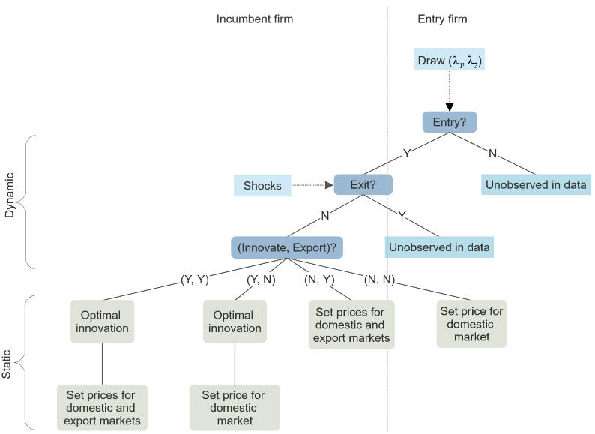
Analytical Framework-Economic Model

Slide 9
Analytical Framework-Economic Model

Slide 10
Analytical Framework-Economic Model

Slide 11
Analytical Framework-Economic Model

Slide 12
Analytical Framework-Economic Model

Slide 13
Analytical Framework-Economic Model
Firms have perfect information in the current period, including the shocks at stage two. However, their information on the states in the future is imperfect, and as such they form belief on the transition of the states in making dynamic decisions.
The equilibrium is a set of optimal decisions on entry, exit, whether to innovation and export, optimal level of product innovation, and prices in domestic and export markets, together with cut-off capabilities, that clear the markets and firms’ belief is correct.

Slide 14

Analytical Framework-Economic Model
Demand
$q=Ap^{1/{ρ−1}}$
$q≡{\left[q_{o}^{ρ}+{\left(ζq_{n}\right)}^{ρ}\right]}^{1/ρ}$
$\tilde{q}=\tilde{A}{\tilde{p}}^{1/{\tilde{ρ}−1}}$
$\tilde{q}≡{\left[{\tilde{q}}_{o}^{ρ}+{\left(ζ{\tilde{q}}_{n}\right)}^{ρ}\right]}^{1/ρ}$

Slide 15
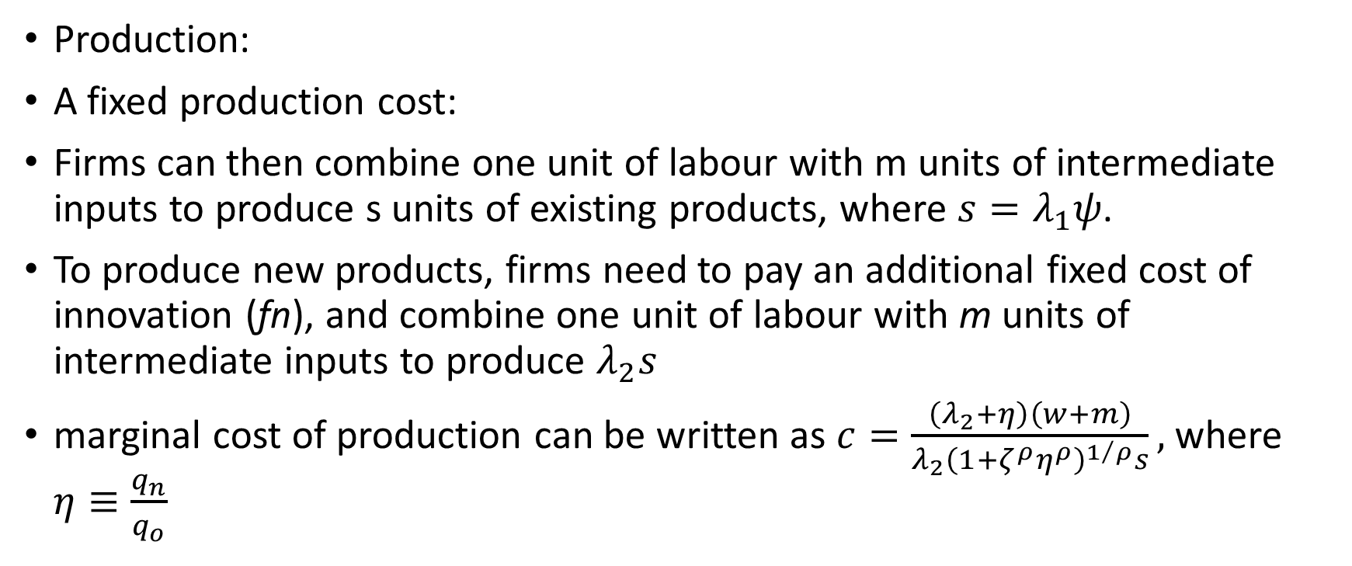
Analytical Framework-Economic Model
Production:
A fixed production cost:
Firms can then combine one unit of labour with m units of intermediate inputs to produce s units of existing products, where $s=λ_{1}ψ$.
To produce new products, firms need to pay an additional fixed cost of innovation (fn), and combine one unit of labour with m units of intermediate inputs to produce $λ_{2}s$
marginal cost of production can be written as $c=\frac{\left(λ_{2}+η\right)\left(w+m\right)}{λ_{2}{\left(1+ζ^{ρ}η^{ρ}\right)}^{1/ρ}s},$ where $η≡\frac{q_{n}}{q_{o}}$

Slide 16
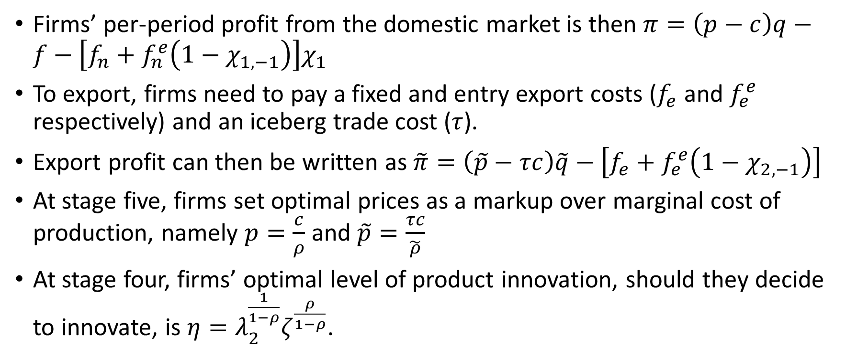
Analytical Framework-Economic Model
Firms’ per-period profit from the domestic market is then $π=\left(p−c\right)q−f−\left[f_{n}+f_{n}^{e}\left(1−χ_{1,−1}\right)\right]χ_{1}$
To export, firms need to pay a fixed and entry export costs ($f_{e}$ and $f_{e}^{e}$ respectively) and an iceberg trade cost ($τ$).
Export profit can then be written as $\tilde{π}=\left(\tilde{p}−τc\right)\tilde{q}−\left[f_{e}+f_{e}^{e}\left(1−χ_{2,−1}\right)\right]$
At stage five, firms set optimal prices as a markup over marginal cost of production, namely $p=\frac{c}{ρ}$ and $\tilde{p}=\frac{τc}{\tilde{ρ}}$
At stage four, firms’ optimal level of product innovation, should they decide to innovate, is $η=λ_{2}^{\frac{1}{1−ρ}}ζ^{\frac{ρ}{1−ρ}}$.

Slide 17
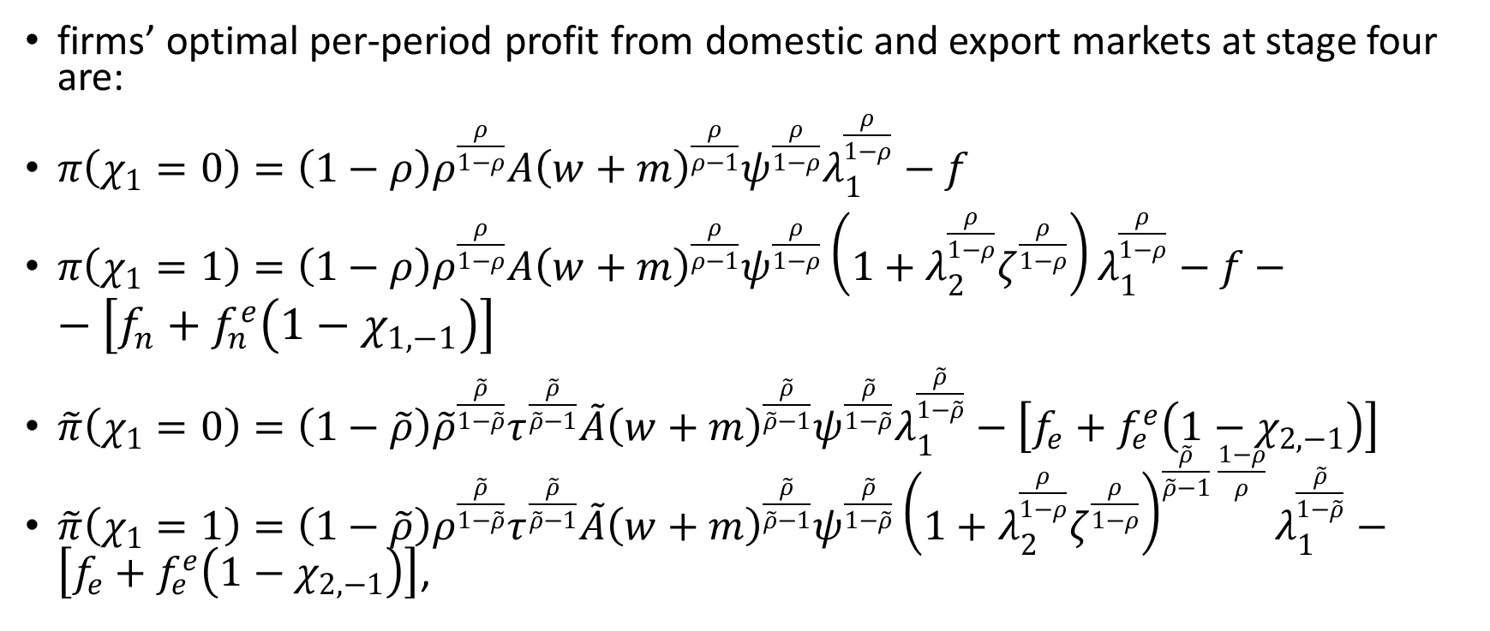
Analytical Framework-Economic Model
firms’ optimal per-period profit from domestic and export markets at stage four are:
$π\left(χ_{1}=0\right)=\left(1−ρ\right)ρ^{\frac{ρ}{1−ρ}}A{\left(w+m\right)}^{\frac{ρ}{ρ−1}}ψ^{\frac{ρ}{1−ρ}}λ_{1}^{\frac{ρ}{1−ρ}}−f$
$π\left(χ_{1}=1\right)=\left(1−ρ\right)ρ^{\frac{ρ}{1−ρ}}A{\left(w+m\right)}^{\frac{ρ}{ρ−1}}ψ^{\frac{ρ}{1−ρ}}\left(1+λ_{2}^{\frac{ρ}{1−ρ}}ζ^{\frac{ρ}{1−ρ}}\right)λ_{1}^{\frac{ρ}{1−ρ}}−f−−\left[f_{n}+f_{n}^{e}\left(1−χ_{1,−1}\right)\right]$
$\tilde{π}\left(χ_{1}=0\right)=\left(1−\tilde{ρ}\right){\tilde{ρ}}^{\frac{\tilde{ρ}}{1−\tilde{ρ}}}τ^{\frac{\tilde{ρ}}{\tilde{ρ}−1}}\tilde{A}{\left(w+m\right)}^{\frac{\tilde{ρ}}{\tilde{ρ}−1}}ψ^{\frac{\tilde{ρ}}{1−\tilde{ρ}}}λ_{1}^{\frac{\tilde{ρ}}{1−\tilde{ρ}}}−\left[f_{e}+f_{e}^{e}\left(1−χ_{2,−1}\right)\right]$
$\tilde{π}\left(χ_{1}=1\right)=\left(1−\tilde{ρ}\right)ρ^{\frac{\tilde{ρ}}{1−\tilde{ρ}}}τ^{\frac{\tilde{ρ}}{\tilde{ρ}−1}}\tilde{A}{\left(w+m\right)}^{\frac{\tilde{ρ}}{\tilde{ρ}−1}}ψ^{\frac{\tilde{ρ}}{1−\tilde{ρ}}}{\left(1+λ_{2}^{\frac{ρ}{1−ρ}}ζ^{\frac{ρ}{1−ρ}}\right)}^{\frac{\tilde{ρ}}{\tilde{ρ}−1} \frac{1−ρ}{ρ}}λ_{1}^{\frac{\tilde{ρ}}{1−\tilde{ρ}}}−\left[f_{e}+f_{e}^{e}\left(1−χ_{2,−1}\right)\right]$,

Slide 18
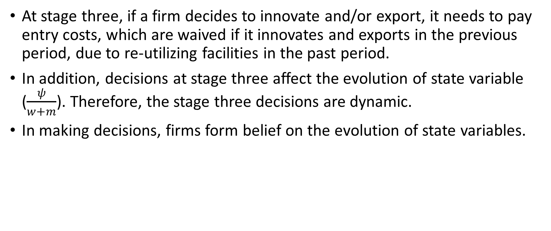
Analytical Framework-Economic Model
At stage three, if a firm decides to innovate and/or export, it needs to pay entry costs, which are waived if it innovates and exports in the previous period, due to re-utilizing facilities in the past period.
In addition, decisions at stage three affect the evolution of state variable ($\frac{ψ}{w+m}$). Therefore, the stage three decisions are dynamic.
In making decisions, firms form belief on the evolution of state variables.

Slide 19
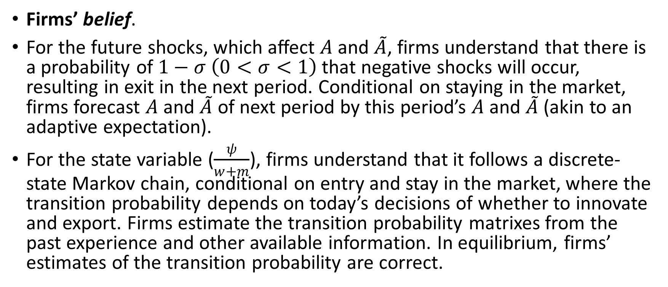
Analytical Framework-Economic Model
Firms’ belief.
For the future shocks, which affect $A$ and $\tilde{A}$, firms understand that there is a probability of $1−σ$ $\left(0<σ<1\right)$ that negative shocks will occur, resulting in exit in the next period. Conditional on staying in the market, firms forecast $A$ and $\tilde{A}$ of next period by this period’s $A$ and $\tilde{A}$ (akin to an adaptive expectation).
For the state variable ($\frac{ψ}{w+m}$), firms understand that it follows a discrete-state Markov chain, conditional on entry and stay in the market, where the transition probability depends on today’s decisions of whether to innovate and export. Firms estimate the transition probability matrixes from the past experience and other available information. In equilibrium, firms’ estimates of the transition probability are correct.

Slide 20

Analytical Framework-Economic Model
Given firms’ belief, we can obtain their value functions.
The value of choosing $\left(χ_{1},χ_{2}\right)=\left(0,0\right)$, normalized by the fixed cost of production, is $v_{\left(0,0\right)}≡\frac{1}{f}{\check{v}}_{\left(0,0\right)}=\left(1−ρ\right)ρ^{\frac{ρ}{1−ρ}}\frac{1}{f}A{\left(w+m\right)}^{\frac{ρ}{ρ−1}}ψ^{\frac{ρ}{1−ρ}}λ_{1}^{\frac{ρ}{1−ρ}}−1+δσ{Ev}_{\left(0,0\right)}$

Slide 21
Analytical Framework-Economic Model
At stage two, if the realized shock is negative (namely it reduces the per-period profit) and sufficiently large such that the value of staying in the market is less than its liquidation value, the firm exits.
At stage one, firms’ value functions depend on their capability endowments. If the realized capability endowments are such that the value functions are negative, firms do not enter the market.
The stage two decision results in an endogenous sample attrition, while the stage one problem leads to an endogenous sample selection.

Slide 22
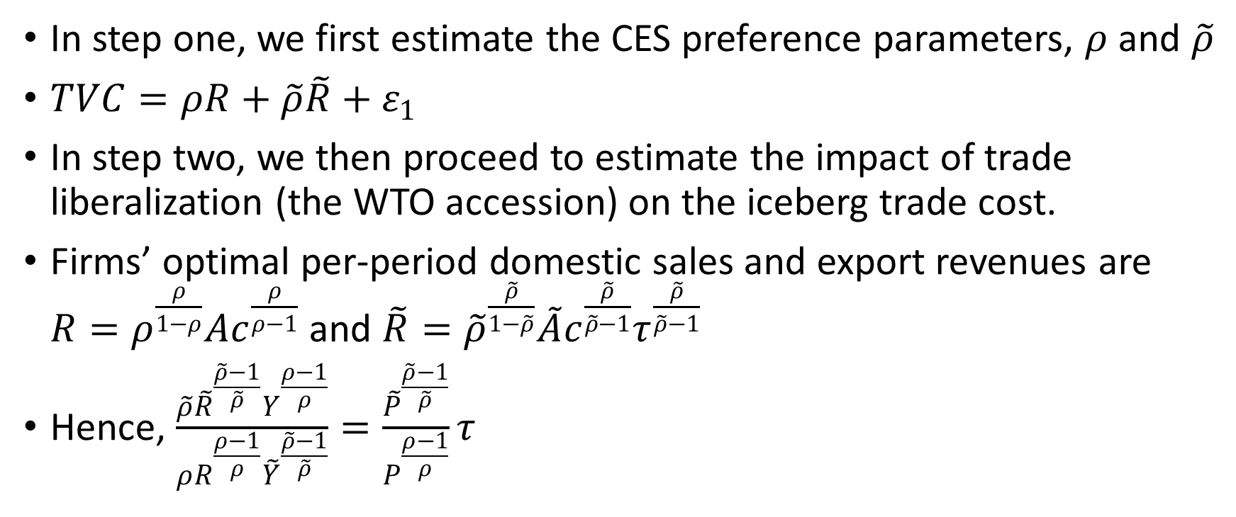
Analytical Framework-Estimation Strategy
In step one, we first estimate the CES preference parameters, $ρ$ and $\tilde{ρ}$
$TVC=ρR+\tilde{ρ}\tilde{R}+ε_{1}$
In step two, we then proceed to estimate the impact of trade liberalization (the WTO accession) on the iceberg trade cost.
Firms’ optimal per-period domestic sales and export revenues are $R=ρ^{\frac{ρ}{1−ρ}}Ac^{\frac{ρ}{ρ−1}}$ and $\tilde{R}={\tilde{ρ}}^{\frac{\tilde{ρ}}{1−\tilde{ρ}}}\tilde{A}c^{\frac{\tilde{ρ}}{\tilde{ρ}−1}}τ^{\frac{\tilde{ρ}}{\tilde{ρ}−1}}$
Hence, $\frac{\tilde{ρ}{\tilde{R}}^{\frac{\tilde{ρ}−1}{\tilde{ρ}}}Y^{\frac{ρ−1}{ρ}}}{ρR^{\frac{ρ−1}{ρ}}{\tilde{Y}}^{\frac{\tilde{ρ}−1}{\tilde{ρ}}}}=\frac{{\tilde{P}}^{\frac{\tilde{ρ}−1}{\tilde{ρ}}}}{P^{\frac{ρ−1}{ρ}}}τ$

Slide 23
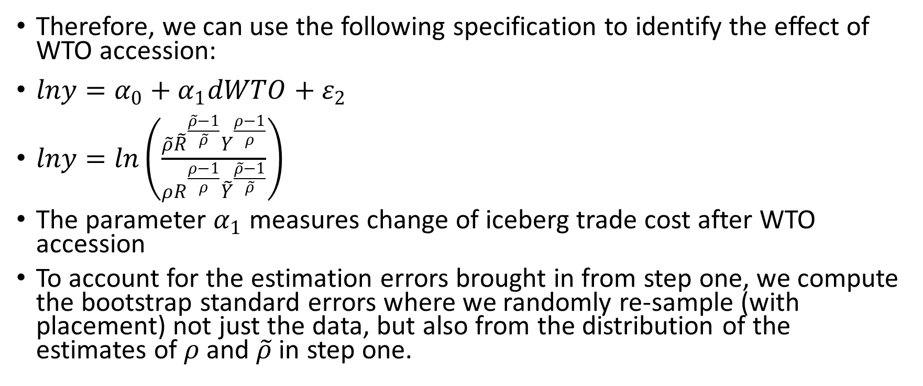
Analytical Framework-Estimation Strategy
Therefore, we can use the following specification to identify the effect of WTO accession:
$lny=α_{0}+α_{1}dWTO+ε_{2}$
$lny=ln\left(\frac{\tilde{ρ}{\tilde{R}}^{\frac{\tilde{ρ}−1}{\tilde{ρ}}}Y^{\frac{ρ−1}{ρ}}}{ρR^{\frac{ρ−1}{ρ}}{\tilde{Y}}^{\frac{\tilde{ρ}−1}{\tilde{ρ}}}}\right)$
The parameter $α_{1}$ measures change of iceberg trade cost after WTO accession
To account for the estimation errors brought in from step one, we compute the bootstrap standard errors where we randomly re-sample (with placement) not just the data, but also from the distribution of the estimates of $ρ$ and $\tilde{ρ}$ in step one.

Slide 24
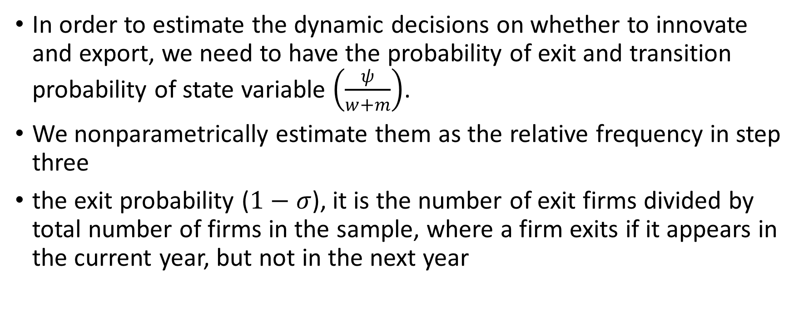
Analytical Framework-Estimation Strategy
In order to estimate the dynamic decisions on whether to innovate and export, we need to have the probability of exit and transition probability of state variable $\left(\frac{ψ}{w+m}\right)$.
We nonparametrically estimate them as the relative frequency in step three
the exit probability ($1−σ$), it is the number of exit firms divided by total number of firms in the sample, where a firm exits if it appears in the current year, but not in the next year

Slide 25
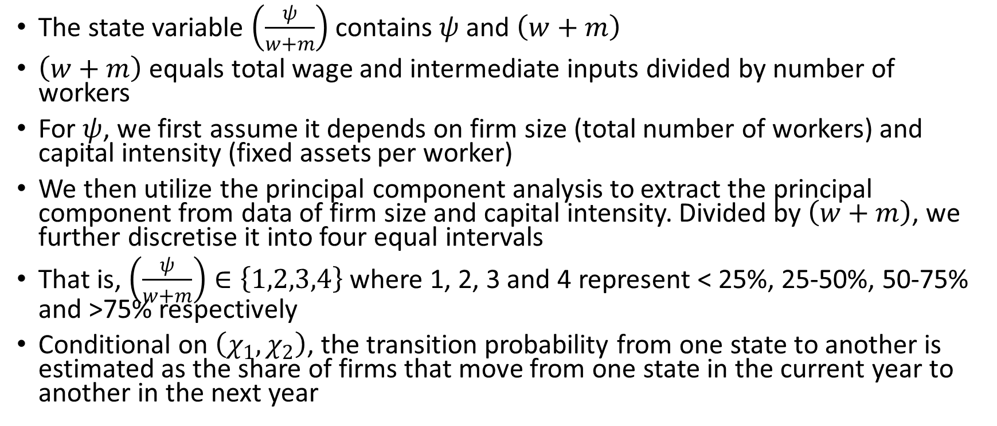
Analytical Framework-Estimation Strategy
The state variable $\left(\frac{ψ}{w+m}\right)$ contains $ψ$ and $\left(w+m\right)$
$\left(w+m\right)$ equals total wage and intermediate inputs divided by number of workers
For $ψ$, we first assume it depends on firm size (total number of workers) and capital intensity (fixed assets per worker)
We then utilize the principal component analysis to extract the principal component from data of firm size and capital intensity. Divided by $\left(w+m\right)$, we further discretise it into four equal intervals
That is, $\left(\frac{ψ}{w+m}\right)∈\left\{1,2,3,4\right\}$ where 1, 2, 3 and 4 represent < 25%, 25-50%, 50-75% and >75% respectively
Conditional on $\left(χ_{1},χ_{2}\right)$, the transition probability from one state to another is estimated as the share of firms that move from one state in the current year to another in the next year

Slide 26
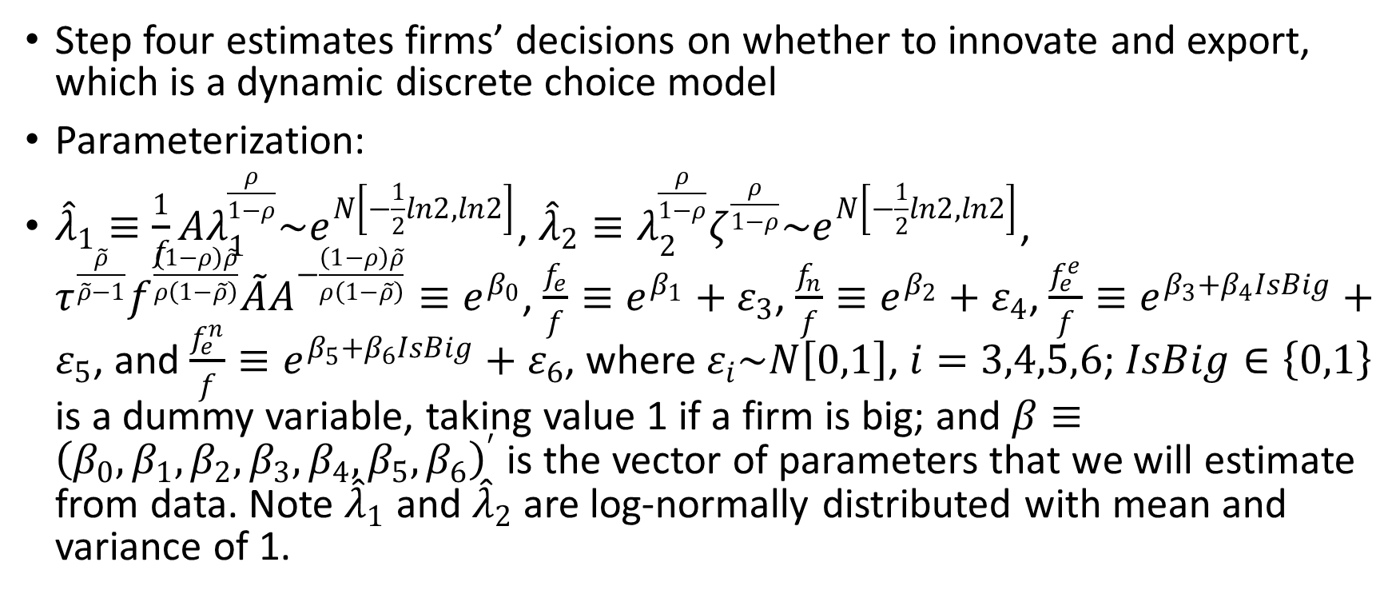
Analytical Framework-Estimation Strategy
Step four estimates firms’ decisions on whether to innovate and export, which is a dynamic discrete choice model
Parameterization:
${\hat{λ}}_{1}≡\frac{1}{f}Aλ_{1}^{\frac{ρ}{1−ρ}}\sim e^{N\left[−\frac{1}{2}ln2,ln2\right]}$, ${\hat{λ}}_{2}≡λ_{2}^{\frac{ρ}{1−ρ}}ζ^{\frac{ρ}{1−ρ}}\sim e^{N\left[−\frac{1}{2}ln2,ln2\right]}$, $τ^{\frac{\tilde{ρ}}{\tilde{ρ}−1}}f^{\frac{\left(1−ρ\right)\tilde{ρ}}{ρ\left(1−\tilde{ρ}\right)}}\tilde{A}A^{−\frac{\left(1−ρ\right)\tilde{ρ}}{ρ\left(1−\tilde{ρ}\right)}}≡e^{β_{0}}$, $\frac{f_{e}}{f}≡e^{β_{1}}+ε_{3}$, $\frac{f_{n}}{f}≡e^{β_{2}}+ε_{4}$, $\frac{f_{e}^{e}}{f}≡e^{β_{3}+β_{4}IsBig}+ε_{5}$, and $\frac{f_{e}^{n}}{f}≡e^{β_{5}+β_{6}IsBig}+ε_{6}$, where $ε_{i}\sim N\left[0,1\right]$, $i=3,4,5,6$; $IsBig∈\left\{0,1\right\}$ is a dummy variable, taking value 1 if a firm is big; and $β≡{\left(β_{0},β_{1},β_{2},β_{3},β_{4},β_{5},β_{6}\right)}^{′}$ is the vector of parameters that we will estimate from data. Note ${\hat{λ}}_{1}$ and ${\hat{λ}}_{2}$ are log-normally distributed with mean and variance of 1.

Slide 27
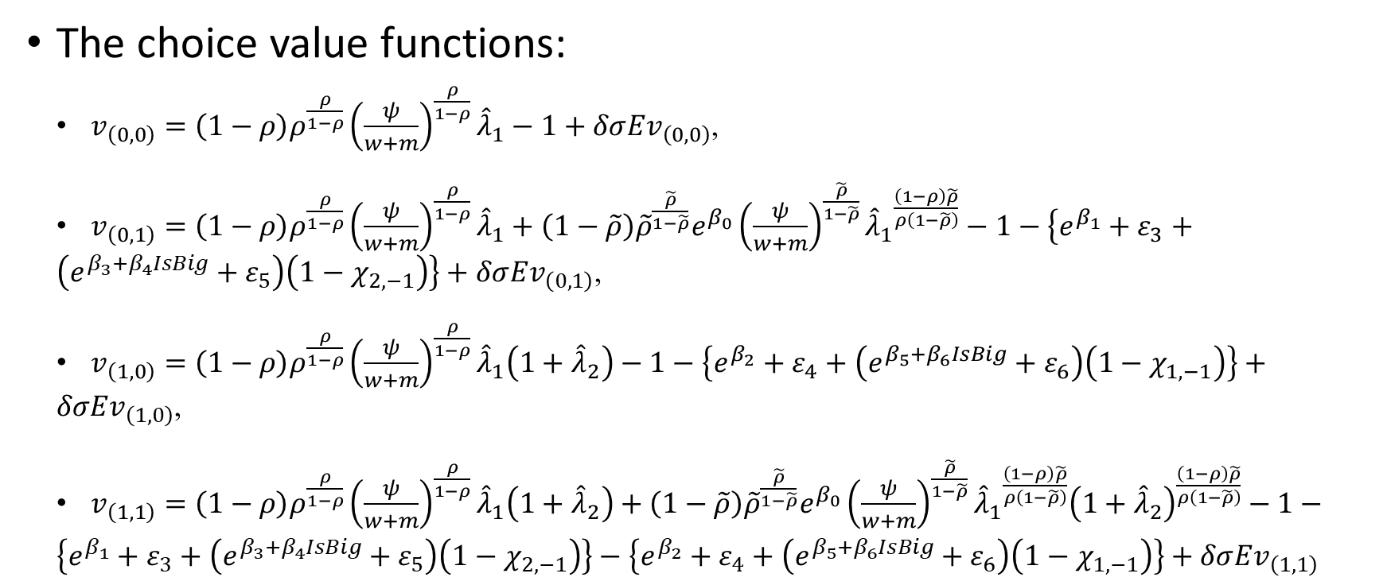
Analytical Framework-Estimation Strategy
The choice value functions:
$v_{\left(0,0\right)}=\left(1−ρ\right)ρ^{\frac{ρ}{1−ρ}}{\left(\frac{ψ}{w+m}\right)}^{\frac{ρ}{1−ρ}}{\hat{λ}}_{1}−1+δσ{Ev}_{\left(0,0\right)}$,
$v_{\left(0,1\right)}=\left(1−ρ\right)ρ^{\frac{ρ}{1−ρ}}{\left(\frac{ψ}{w+m}\right)}^{\frac{ρ}{1−ρ}}{\hat{λ}}_{1}+\left(1−\tilde{ρ}\right){\tilde{ρ}}^{\frac{\tilde{ρ}}{1−\tilde{ρ}}}e^{β_{0}}{\left(\frac{ψ}{w+m}\right)}^{\frac{\tilde{ρ}}{1−\tilde{ρ}}}{{\hat{λ}}_{1}}^{\frac{\left(1−ρ\right)\tilde{ρ}}{ρ\left(1−\tilde{ρ}\right)}}−1−\left\{e^{β_{1}}+ε_{3}+\left(e^{β_{3}+β_{4}IsBig}+ε_{5}\right)\left(1−χ_{2,−1}\right)\right\}+δσ{Ev}_{\left(0,1\right)}$,
$v_{\left(1,0\right)}=\left(1−ρ\right)ρ^{\frac{ρ}{1−ρ}}{\left(\frac{ψ}{w+m}\right)}^{\frac{ρ}{1−ρ}}{\hat{λ}}_{1}\left(1+{\hat{λ}}_{2}\right)−1−\left\{e^{β_{2}}+ε_{4}+\left(e^{β_{5}+β_{6}IsBig}+ε_{6}\right)\left(1−χ_{1,−1}\right)\right\}+δσ{Ev}_{\left(1,0\right)}$,
$v_{\left(1,1\right)}=\left(1−ρ\right)ρ^{\frac{ρ}{1−ρ}}{\left(\frac{ψ}{w+m}\right)}^{\frac{ρ}{1−ρ}}{\hat{λ}}_{1}\left(1+{\hat{λ}}_{2}\right)+\left(1−\tilde{ρ}\right){\tilde{ρ}}^{\frac{\tilde{ρ}}{1−\tilde{ρ}}}e^{β_{0}}{\left(\frac{ψ}{w+m}\right)}^{\frac{\tilde{ρ}}{1−\tilde{ρ}}}{{\hat{λ}}_{1}}^{\frac{\left(1−ρ\right)\tilde{ρ}}{ρ\left(1−\tilde{ρ}\right)}}{\left(1+{\hat{λ}}_{2}\right)}^{\frac{\left(1−ρ\right)\tilde{ρ}}{ρ\left(1−\tilde{ρ}\right)}}−1−\left\{e^{β_{1}}+ε_{3}+\left(e^{β_{3}+β_{4}IsBig}+ε_{5}\right)\left(1−χ_{2,−1}\right)\right\}−\left\{e^{β_{2}}+ε_{4}+\left(e^{β_{5}+β_{6}IsBig}+ε_{6}\right)\left(1−χ_{1,−1}\right)\right\}+δσ{Ev}_{\left(1,1\right)}$

Slide 28
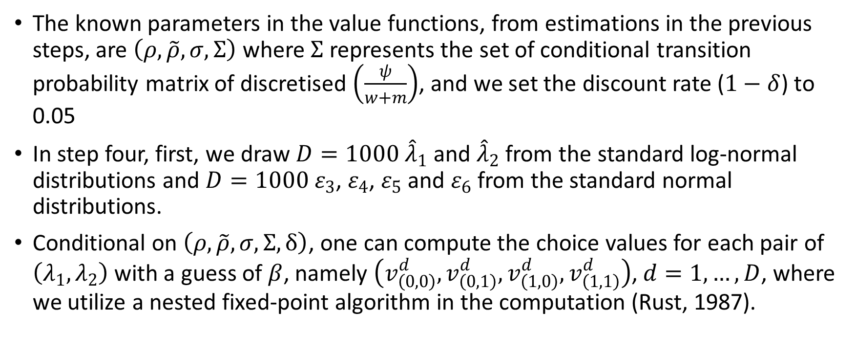
Analytical Framework-Estimation Strategy
The known parameters in the value functions, from estimations in the previous steps, are $\left(ρ,\tilde{ρ},σ,Σ\right)$ where $Σ$ represents the set of conditional transition probability matrix of discretised $\left(\frac{ψ}{w+m}\right)$, and we set the discount rate ($1−δ$) to 0.05
In step four, first, we draw $D=1000$ ${\hat{λ}}_{1}$ and ${\hat{λ}}_{2}$ from the standard log-normal distributions and $D=1000$ $ε_{3}$, $ε_{4}$, $ε_{5}$ and $ε_{6}$ from the standard normal distributions.
Conditional on $\left(ρ,\tilde{ρ},σ,Σ,δ\right)$, one can compute the choice values for each pair of $\left(λ_{1},λ_{2}\right)$ with a guess of $β$, namely $\left(v_{\left(0,0\right)}^{d},v_{\left(0,1\right)}^{d},v_{\left(1,0\right)}^{d},v_{\left(1,1\right)}^{d}\right)$, $d=1,…,D$, where we utilize a nested fixed-point algorithm in the computation (Rust, 1987).

Slide 29
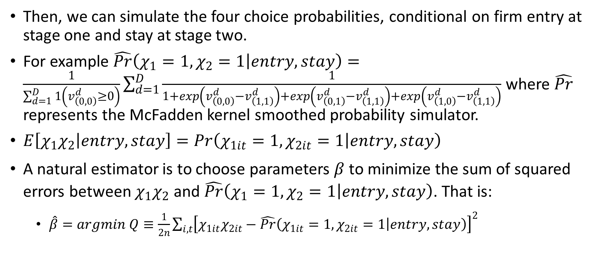
Analytical Framework-Estimation Strategy
Then, we can simulate the four choice probabilities, conditional on firm entry at stage one and stay at stage two.
For example $\hat{Pr}\left(\left.χ_{1}=1,χ_{2}=1\right|entry,stay\right)=\frac{1}{\sum_{d=1}^{D}{1\left(v_{\left(0,0\right)}^{d}≥0\right)}}\sum_{d=1}^{D}{\frac{1}{1+exp\left(v_{\left(0,0\right)}^{d}−v_{\left(1,1\right)}^{d}\right)+exp\left(v_{\left(0,1\right)}^{d}−v_{\left(1,1\right)}^{d}\right)+exp\left(v_{\left(1,0\right)}^{d}−v_{\left(1,1\right)}^{d}\right)}}$ where $\hat{Pr}$ represents the McFadden kernel smoothed probability simulator.
$E\left[\left.χ_{1}χ_{2}\right|entry,stay\right]=Pr\left(\left.χ_{1it}=1,χ_{2it}=1\right|entry,stay\right)$
A natural estimator is to choose parameters $β$ to minimize the sum of squared errors between $χ_{1}χ_{2}$ and $\hat{Pr}\left(\left.χ_{1}=1,χ_{2}=1\right|entry,stay\right)$. That is:
  $\hat{β}=argmin Q≡\frac{1}{2n}\sum_{i,t}{{\left[χ_{1it}χ_{2it}−\hat{Pr}\left(\left.χ_{1it}=1,χ_{2it}=1\right|entry,stay\right)\right]}^{2}}$

Slide 30
Data and Variables
The data are a set of air-conditioner manufacturing firms in China, sourced from the National Bureau of Statistics (NBS), China.
It covers 184 firms in 2000, 232 firms in 2001, 254 firms in 2002, 237 firms in 2003, 201 firms in 2005, 191 firms in 2006, and 206 firms in 2007, where years 2000 and 2001 are pre-WTO accession periods.

Slide 31
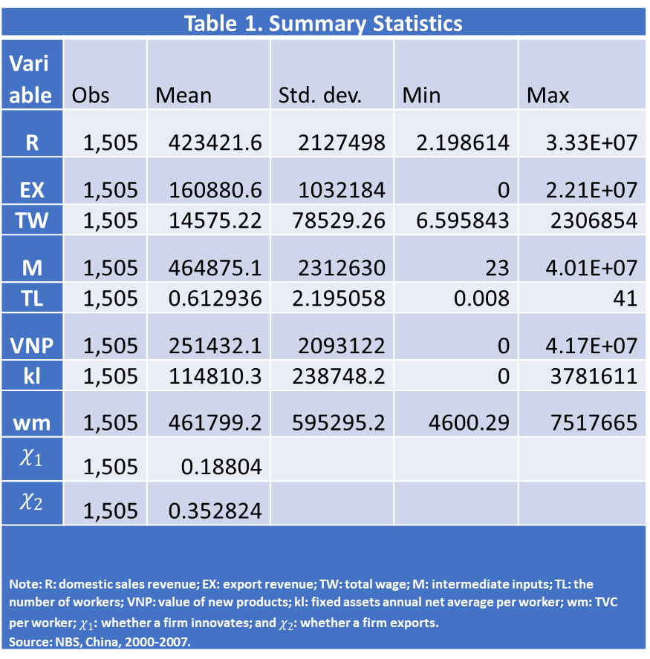
Data and Variables
Table 1. Summary Statistics
Variable | Obs | Mean | Std. dev. | Min | Max
R | 1,505 | 423421.6 | 2127498 | 2.198614 | 3.33E+07
EX | 1,505 | 160880.6 | 1032184 | 0 | 2.21E+07
TW | 1,505 | 14575.22 | 78529.26 | 6.595843 | 2306854
M | 1,505 | 464875.1 | 2312630 | 23 | 4.01E+07
TL | 1,505 | 0.612936 | 2.195058 | 0.008 | 41
VNP | 1,505 | 251432.1 | 2093122 | 0 | 4.17E+07
kl | 1,505 | 114810.3 | 238748.2 | 0 | 3781611
wm | 1,505 | 461799.2 | 595295.2 | 4600.29 | 7517665
$$χ_{1}$$ | 1,505 | 0.18804
$$χ_{2}$$ | 1,505 | 0.352824
Note: R: domestic sales revenue; EX: export revenue; TW: total wage; M: intermediate inputs; TL: the number of workers; VNP: value of new products; kl: fixed assets annual net average per worker; wm: TVC per worker; $χ_{1}$: whether a firm innovates; and $χ_{2}$: whether a firm exports. Source: NBS, China, 2000-2007.

Slide 32
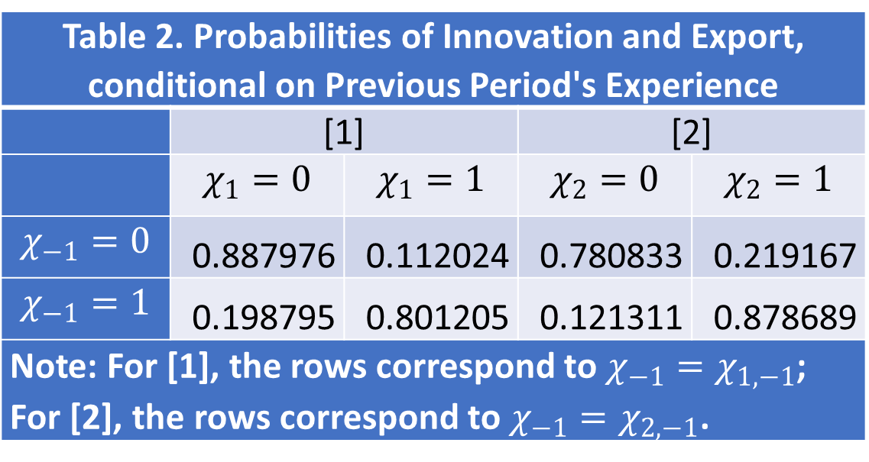
Data and Variables
Table 2. Probabilities of Innovation and Export, conditional on Previous Period's Experience
 | [1] |  | [2]
 | $$χ_{1}=0$$ | $$χ_{1}=1$$ | $$χ_{2}=0$$ | $$χ_{2}=1$$
$$χ_{−1}=0$$ | 0.887976 | 0.112024 | 0.780833 | 0.219167
$$χ_{−1}=1$$ | 0.198795 | 0.801205 | 0.121311 | 0.878689
Note: For [1], the rows correspond to $χ_{−1}=χ_{1,−1}$; For [2], the rows correspond to $χ_{−1}=χ_{2,−1}$.

Slide 33
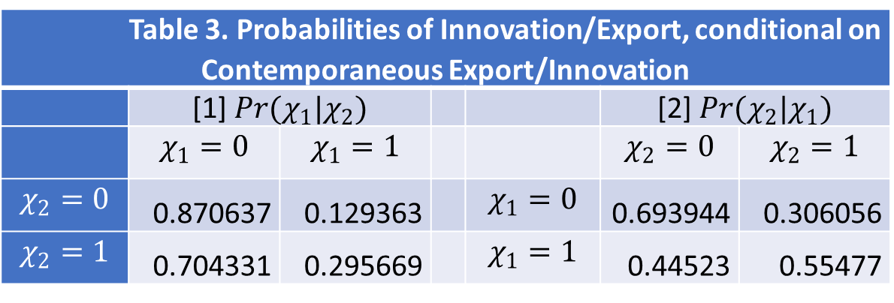
Data and Variables
Table 3. Probabilities of Innovation/Export, conditional on Contemporaneous Export/Innovation
 | [1] $Pr(χ_{1}|χ_{2})$ |  |  |  | [2] $Pr(χ_{2}|χ_{1})$
 | $$χ_{1}=0$$ | $$χ_{1}=1$$ |  |  | $$χ_{2}=0$$ | $$χ_{2}=1$$
$$χ_{2}=0$$ | 0.870637 | 0.129363 |  | $$χ_{1}=0$$ | 0.693944 | 0.306056
$$χ_{2}=1$$ | 0.704331 | 0.295669 |  | $$χ_{1}=1$$ | 0.44523 | 0.55477

Slide 34
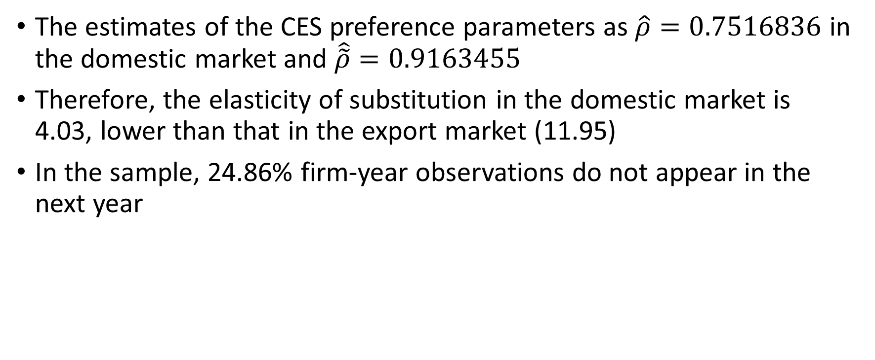
Results
The estimates of the CES preference parameters as $\hat{ρ}=0.7516836$ in the domestic market and $\hat{\tilde{ρ}}=0.9163455$
Therefore, the elasticity of substitution in the domestic market is 4.03, lower than that in the export market (11.95)
In the sample, 24.86% firm-year observations do not appear in the next year

Slide 35
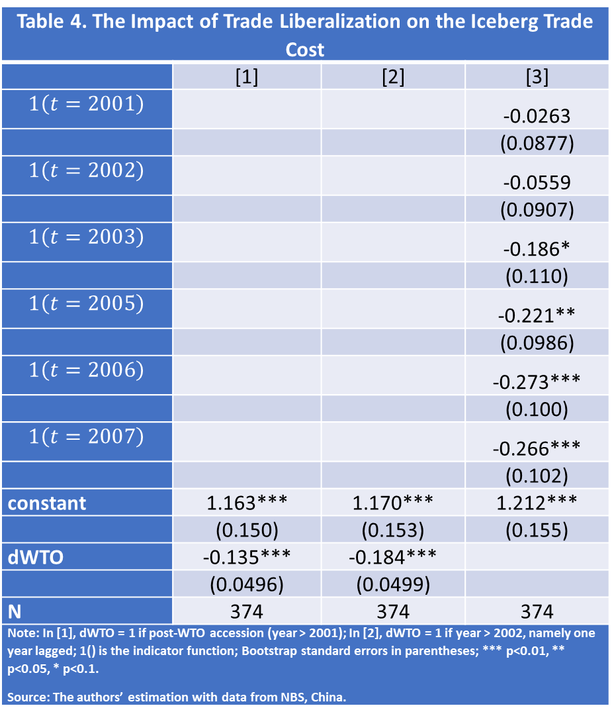
Results
Table 4. The Impact of Trade Liberalization on the Iceberg Trade Cost
 | [1] | [2] | [3]
$$1\left(t=2001\right)$$ |  |  | -0.0263
 |  |  | (0.0877)
$$1\left(t=2002\right)$$ |  |  | -0.0559
 |  |  | (0.0907)
$$1\left(t=2003\right)$$ |  |  | -0.186*
 |  |  | (0.110)
$$1\left(t=2005\right)$$ |  |  | -0.221**
 |  |  | (0.0986)
$$1\left(t=2006\right)$$ |  |  | -0.273***
 |  |  | (0.100)
$$1\left(t=2007\right)$$ |  |  | -0.266***
 |  |  | (0.102)
constant | 1.163*** | 1.170*** | 1.212***
 | (0.150) | (0.153) | (0.155)
dWTO | -0.135*** | -0.184***
 | (0.0496) | (0.0499)
N | 374 | 374 | 374
Note: In [1], dWTO = 1 if post-WTO accession (year > 2001); In [2], dWTO = 1 if year > 2002, namely one year lagged; 1() is the indicator function; Bootstrap standard errors in parentheses; *** p<0.01, ** p<0.05, * p<0.1. Source: The authors’ estimation with data from NBS, China.
The effect of WTO accession

Slide 36

Results
The transition probability matrixes ($\hat{Σ}$)
Export and innovation have a dynamic benefit of helping firms move to a better state, namely $\hat{Σ}\left(χ_{1}=1,χ_{2}=1\right)$, $\hat{Σ}\left(χ_{1}=1,χ_{2}=0\right)$ and $\hat{Σ}\left(χ_{1}=0,χ_{2}=1\right)$ first-order stochastically dominate $\hat{Σ}\left(χ_{1}=0,χ_{2}=0\right)$

Slide 37
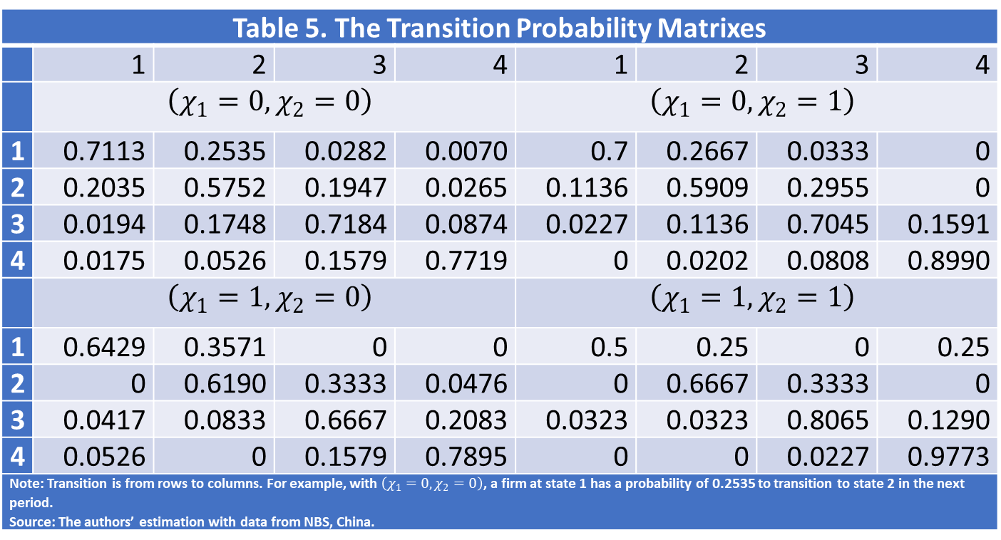
Results
Table 5. The Transition Probability Matrixes
 | 1 | 2 | 3 | 4 | 1 | 2 | 3 | 4
 | $$\left(χ_{1}=0,χ_{2}=0\right)$$ |  |  |  | $$\left(χ_{1}=0,χ_{2}=1\right)$$
1 | 0.7113 | 0.2535 | 0.0282 | 0.0070 | 0.7 | 0.2667 | 0.0333 | 0
2 | 0.2035 | 0.5752 | 0.1947 | 0.0265 | 0.1136 | 0.5909 | 0.2955 | 0
3 | 0.0194 | 0.1748 | 0.7184 | 0.0874 | 0.0227 | 0.1136 | 0.7045 | 0.1591
4 | 0.0175 | 0.0526 | 0.1579 | 0.7719 | 0 | 0.0202 | 0.0808 | 0.8990
 | $$\left(χ_{1}=1,χ_{2}=0\right)$$ |  |  |  | $$\left(χ_{1}=1,χ_{2}=1\right)$$
1 | 0.6429 | 0.3571 | 0 | 0 | 0.5 | 0.25 | 0 | 0.25
2 | 0 | 0.6190 | 0.3333 | 0.0476 | 0 | 0.6667 | 0.3333 | 0
3 | 0.0417 | 0.0833 | 0.6667 | 0.2083 | 0.0323 | 0.0323 | 0.8065 | 0.1290
4 | 0.0526 | 0 | 0.1579 | 0.7895 | 0 | 0 | 0.0227 | 0.9773
Note: Transition is from rows to columns. For example, with $\left(χ_{1}=0,χ_{2}=0\right)$, a firm at state 1 has a probability of 0.2535 to transition to state 2 in the next period. Source: The authors’ estimation with data from NBS, China.

Slide 38
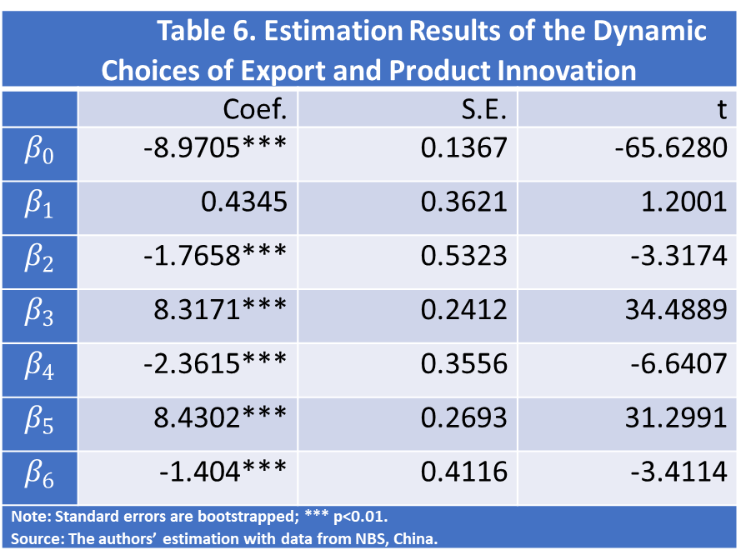
Results
The dynamic decisions on export and product innovation
Table 6. Estimation Results of the Dynamic Choices of Export and Product Innovation
 | Coef. | S.E. | t
$$β_{0}$$ | -8.9705*** | 0.1367 | -65.6280
$$β_{1}$$ | 0.4345 | 0.3621 | 1.2001
$$β_{2}$$ | -1.7658*** | 0.5323 | -3.3174
$$β_{3}$$ | 8.3171*** | 0.2412 | 34.4889
$$β_{4}$$ | -2.3615*** | 0.3556 | -6.6407
$$β_{5}$$ | 8.4302*** | 0.2693 | 31.2991
$$β_{6}$$ | -1.404*** | 0.4116 | -3.4114
Note: Standard errors are bootstrapped; *** p<0.01. Source: The authors’ estimation with data from NBS, China.

Slide 39
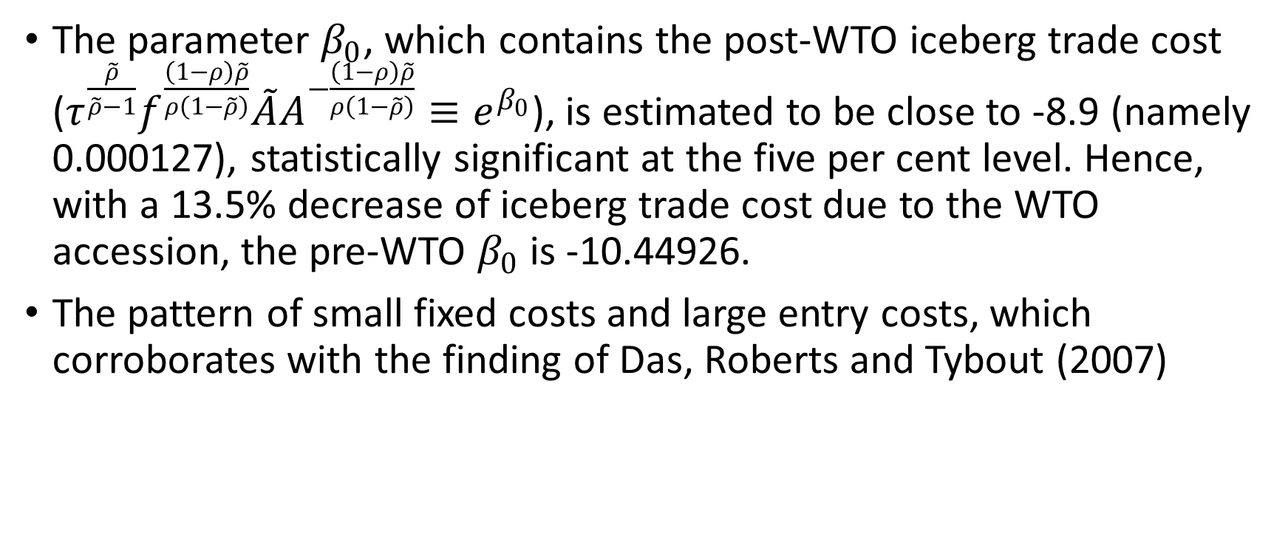
Results
The parameter $β_{0}$, which contains the post-WTO iceberg trade cost ($τ^{\frac{\tilde{ρ}}{\tilde{ρ}−1}}f^{\frac{\left(1−ρ\right)\tilde{ρ}}{ρ\left(1−\tilde{ρ}\right)}}\tilde{A}A^{−\frac{\left(1−ρ\right)\tilde{ρ}}{ρ\left(1−\tilde{ρ}\right)}}≡e^{β_{0}}$), is estimated to be close to -8.9 (namely 0.000127), statistically significant at the five per cent level. Hence, with a 13.5% decrease of iceberg trade cost due to the WTO accession, the pre-WTO $β_{0}$ is -10.44926.
The pattern of small fixed costs and large entry costs, which corroborates with the finding of Das, Roberts and Tybout (2007)

Slide 40
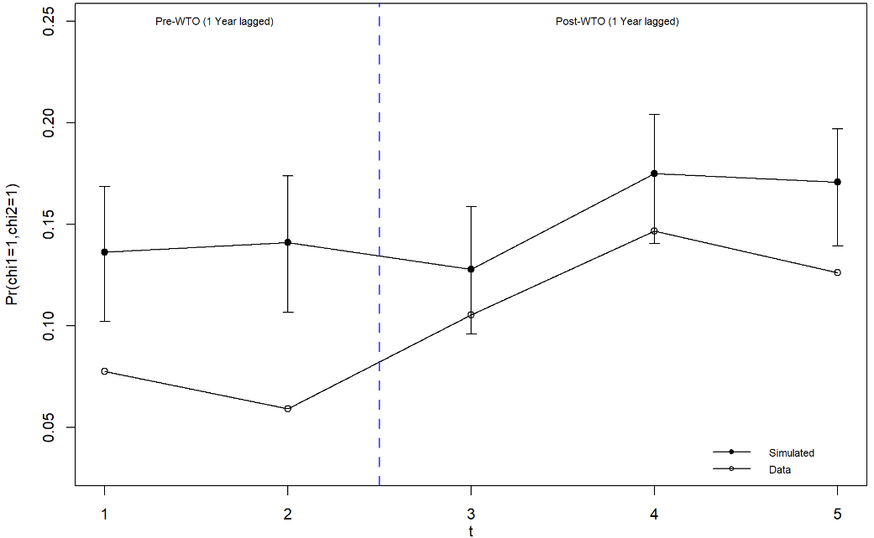
Results
Counterfactual analysis
Figure 2. The Probabilities of Product Innovation and Export
Note: t = 1, year 2001; t = 2, year 2002; t = 3, year 2003; t = 4, year 2006; t = 5, year 2007; The error bars are bootstrap 99% confidence intervals.

Slide 41
Concluding Remarks
This study explores firms’ optimal decisions to export and conduct product innovation both theoretically and empirically.
We find that China’s WTO accession reduces the iceberg trade cost and subsequently promotes export. In turn, the export promotion improves firms’ product innovation through one static channel and two dynamic channels.
Trade liberalization is generally considered to be beneficial in the sense of promoting export and import, particularly for developing economies. In addition, our findings suggest that it can also promote innovation, both in the short and longer terms. Such an additional benefit is somewhat an intended consequence of trade liberalization.

